Slide 1
Automatic Unit Testing Tools
Advanced Software Engineering Seminar
Benny Pasternak
November 2006

Slide 2
Agenda
Quick Survey
Motivation
Unit Test Tools Classification
Generation Tools
  JCrasher
  Eclat
  Symstra
  Test Factoring
More Tools
Future Directions
Summary

Slide 3
Unit Testing – Quick Survey
Definition - a method of testing the correctness of a particular module of source code [Wiki] in isolation
Becoming a substantial part of software development practice (At Microsoft – 79% practice unit tests)
Lots and lots of frameworks and tools out there: xUnit (JUnit,NUnit,CPPUnit), JCrasher, JTest, EasyMock, RhinoMock, …

Slide 4
Motivation for Automatic Unit Testing Tools
Agile methods favor unit testing
  Lots of unit tests needed to test units properly (Unit Tests code is often larger than project code)
  Very helpful in continuous testing (test when idle)
Lots (and lots) of written software out there
  Most have no unit tests at all
  Some have unit tests but not complete
  Some have broken/outdated unit tests

Slide 5
Tool Classification
Frameworks – JUnit, NUnit, etc…
Generation – automatic generation of unit tests
Selection – selecting a small set of unit tests from a large set of unit tests
Prioritization – deciding what is the “best order” to run the tests

Slide 6
Unit Test Generation
Creation of a test suite requires:
  Test input generation – generates unit tests inputs
  Test classification – determines whether tests pass or fail
Manual testing
  Programmers create test inputs using intuition and experience
  Programmers determine proper output for each input using informal reasoning or experimentation

Slide 7
Unit Test Generation - Alternatives
Use of formal specifications
Can be formulated in various ways such as DBC
Can aid in test input generation and classification
Realistically, specifications are time-consuming and difficult to produce manually
Often do not exist in practice.

Slide 8
Unit Test Generation
Goal - provide a bare class (no specifications) to an automatic tool which generates a minimal, but thorough and comprehensive unit test suite.

Slide 9
Input Generation Techniques
Random Execution
  random sequences of method calls with random values
Symbolic Execution
  method sequences with symbolic arguments
  builds constraints on arguments
  produces actual values by solving constraints
Capture & Replay
  capture real sequences seen in actual program runs or test runs

Slide 10
Classification Techniques
Uncaught Exceptions
  Classifies a test as potentially faulty if it throws an uncaught exception
Operation Model
  Infer an operational model from manual tests
  Properties: objects invariants, method pre/post conditions
  Properties violation → potentially faulty
Capture & Replay
  Compare test results/state changes to the ones captured in actual program runs and classify deviations as possible errors.

Slide 11
Generation Tool Map
Generation
Selection
Prioritization
Uncaught
Exceptions
Operational
Model
Random Execution
JCrasher
Jartege
JTest
Eclat
Rostra
Symstra
Symbolic Execution
PathFinder
Symclat
Capture & Replay
Test Factoring
SCRAPE
CR Tool
Substra
GenuTest

Slide 12
Tools we will cover
JCrasher (Random & Uncaught Exceptions)
Eclat (Random & Operational Model)
Symstra (Symbolic & Uncaught Exceptions)
Automatic Test Factoring (Capture & Replay)

Slide 13

JCrasher – An Automatic Robustness Tester for Java (2003)
Christoph Csallner Yannis Smaragdakis
Available at
http://www-static.cc.gatech.edu/grads/c/csallnch/jcrasher/

Slide 14
Goal
Robustness quality goal – “a public method should not throw an unexpected runtime exception when encountering an internal problem, regardless of the parameters provided.”
Goal does not assume anything about domain
Robustness goal applies to all classes
Function to determine class under test robustness: exception type → { pass | fail }

Slide 15
Parameter Space
Huge parameter space.
  Example: m(int,int) has 2^64 param combinations
  Covering all parameters combination is impossible
May not need all combinations to cover all control paths that throw an exception
  Pick a random sample
  Control flow analysis on byte code could derive parameter equivalence class

Slide 16
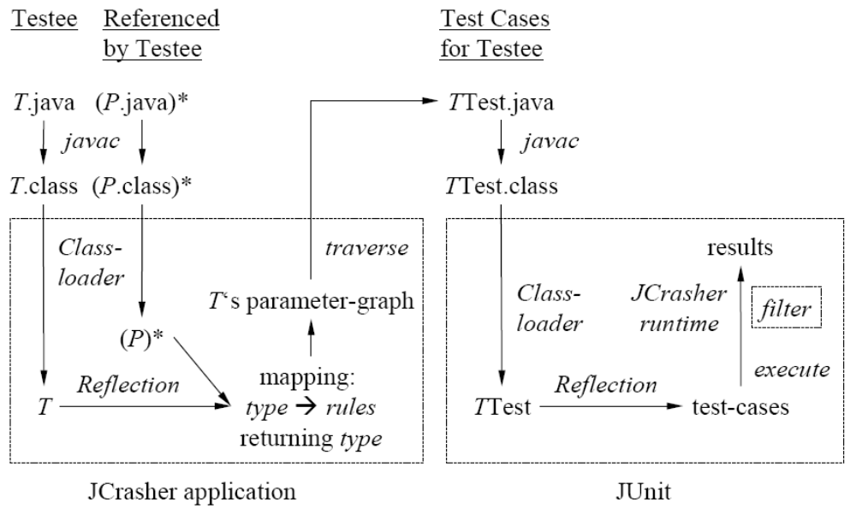
Architecture Overview

Slide 17
Type Inference Rules
Search class under test for inference rules
Transitively search referenced types
Inference Rules
  Method T.m(P1,P2,.., Pn) returns X:
    X ← Y, P1, P2, … , Pn
  Sub-type Y {extend | implements } X:
    X ← Y
Add each discovered inference rule to mapping:
X → inference rules returning X

Slide 18
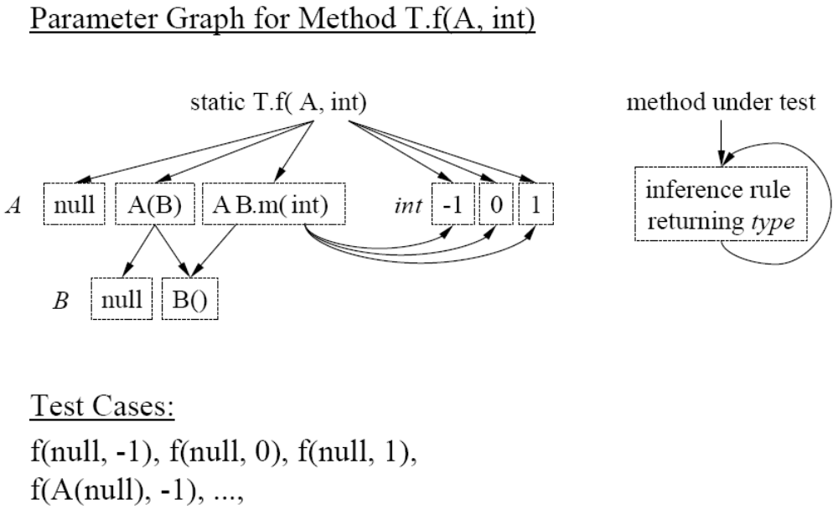
Generate Test Cases For a Method

Slide 19
Exception Filtering
JCrasher runtime catches all exceptions
  Example generated test case:
  Public void test1() throws Throwable {
  try { /* test case */ }
  catch (Exception e) {
  dispatchException(e); // JCrasher runtime
  }
Uses heuristics to decide whether the exception is a
  Bug of the class → pass exception on to JUnit
  Expected exception → suppress exception

Slide 20
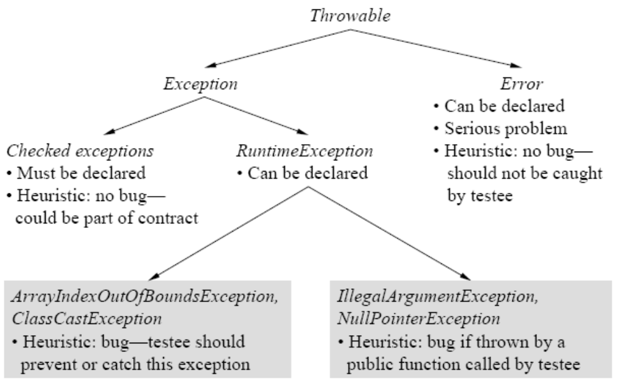
Exception Filter Heuristics

Slide 21
Generation
Symbolic Execution
Dynamic
Test Factoring
PathFinder
CR Tool
Symstra
GenuTest
Substra
Symclat
Eclat
Orstra
Jartege
JCrasher
Random Generation

Slide 22

Eclat: Automatic Generation and Classification of Test Inputs (2005)
Carlos Pacheco Michael D.Ernst
Available at http://pag.csail.mit.edu/eclat

Slide 23
Eclat - Introduction
Challenge in testing software is using a small set of test cases revealing many errors as possible.
A test case consists of an input and an oracle which determines if the behavior on an input is as expected
Input generation can be automated
Oracle construction remains a largely manual (unless a formal specification exists)
Contribution – Eclat helps creating new test cases (input + oracle)

Slide 24
Eclat – Overview
Uses input selection technique to select a small subset from a large set of test inputs
Works by comparing program’s behavior on a given input against an operational model of correct operation
Operational model is derived from an example program execution

Slide 25
Eclat – How?
If program violates the operational model when run on an input, input is classified as:
  illegal input, program is not required to handle it
  likely to produce normal operation (despite model violation)
  likely to reveal a fault

Slide 26
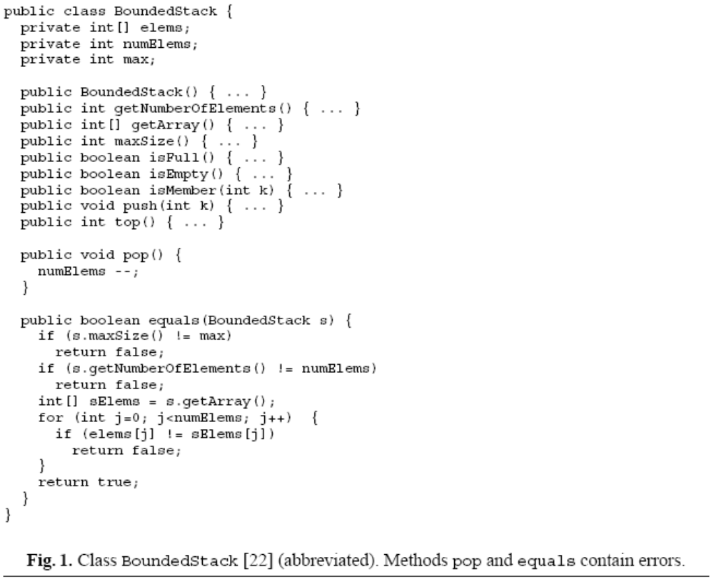
Eclat – BoundedStack example
Can anyone spot the errors?

Slide 27
Eclat – BoundedStack example
Implementation and testing code written by two students, an “author” and a “tester”
Tester wrote set of axioms and author implemented
Tester also wrote manually two test suites (one containing 8 tests, and the other 12)
Smaller test suite doesn’t reveal errors, while the Larger one reveals one error
Eclat’s Input: Class under test, executable program that exercises the class (in this case the 8 test case test suite)

Slide 28
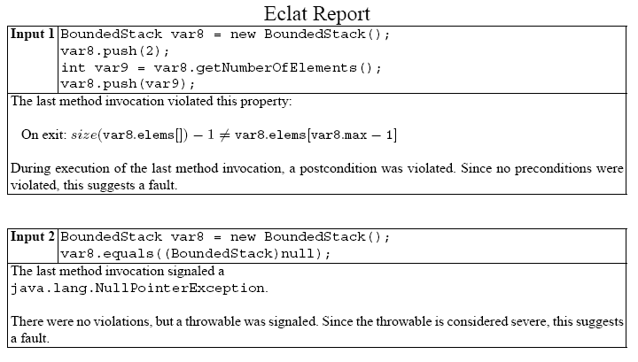
Eclat - Example

Slide 29
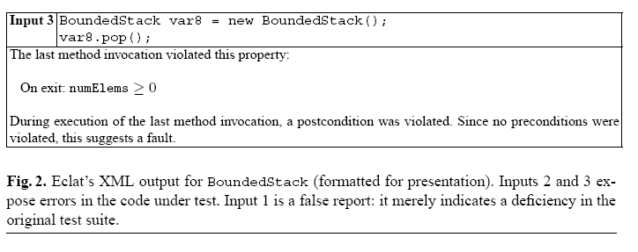
Eclat - Example

Slide 30
Eclat – Example Summary
Generates 806 distinct inputs and discards
  Those that violate no properties, no exception
  Those that violate properties but make illegal use of the class
  Those that violate properties but considered a new use of the class
  Those that behave like already chosen inputs
Created 3 inputs that quickly lead to discover two errors

Slide 31
Eclat - Input Selection
Requires three things:
  Program under test
  Set of correct executions of the program (for example an existing passing test suite)
  A source of candidate inputs (illegal, correct, fault revealing)

Slide 32
Input Selection
Selection technique has three steps:
  Model Generation – Create an operational model from observing the program’s behavior on correct executions.
  Classification – Classify each candidate as (1) illegal (2) normal operation (3) fault-revealing. Done by executing the input and comparing behavior against the operational model
  Reduction – Partition fault-revealing candidates based on their violation pattern and report one candidate from each partition

Slide 33
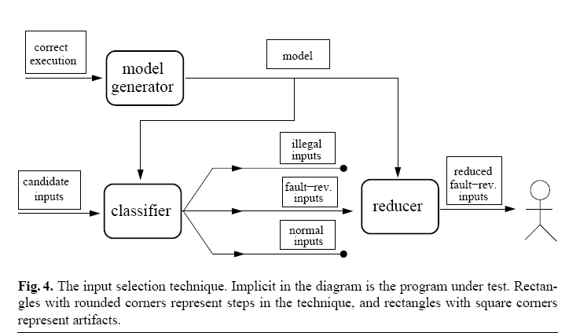
Input Selection

Slide 34
Operational Model
Consists of properties that hold at the boundary of program components (e.g., on public method’s entry and exit)
Uses operational abstractions generated by the Daikon invariant detector

Slide 35
Word on Daikon
Dynamically Discovering Likely Program Invariants
Can detect properties in C, C++, Java, Perl; in spreadsheet files; and in other data sources
Daikon infers many kinds of invariants:
  Invariants over any variables: constants, uninitialized
  Invariants over a numeric variable: range limit, non-zero
  Invariants over two numeric variables:
    linear relationship y=ax+b, ordering comparison
  Invariants over a single sequence variable
    Range: Minimum and maximum sequence values, Ordering

Slide 36
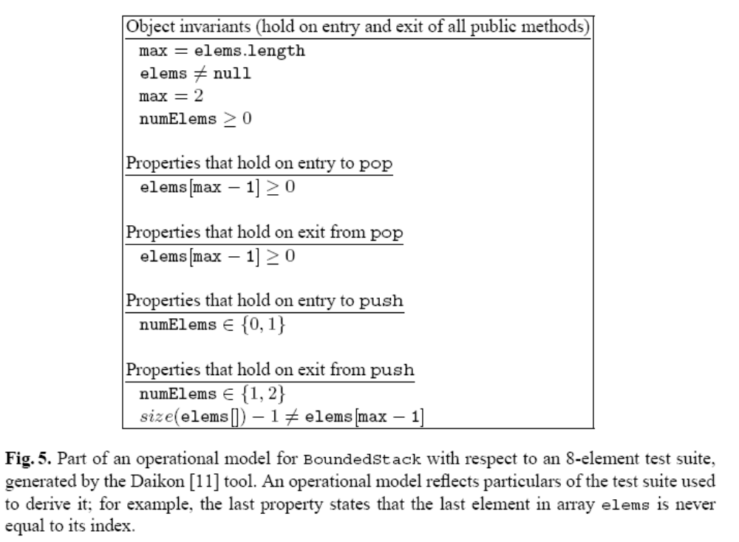
Operational Model

Slide 37
The Classifier
Labels candidate input as illegal, normal operation, fault-revealing
Takes 3 arguments: candidate input, program under test, operational model
Runs the program on the input and checks which model properties are violated
Violation means program behavior on input deviated from previous behavior of program

Slide 38
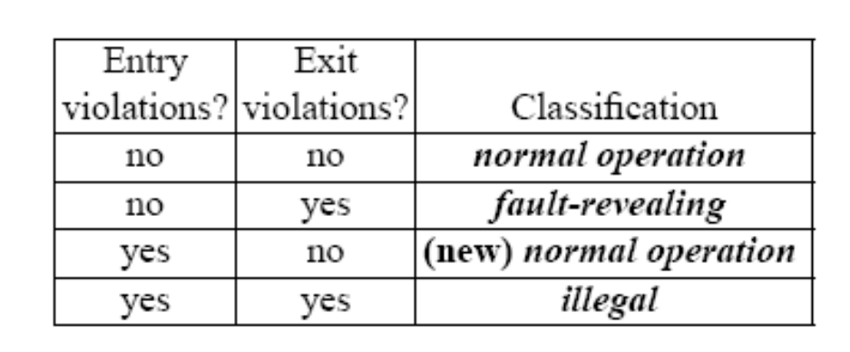
The Classifier (continued)
Previous seen behavior may be incomplete ➔ violation doesn’t necessarily imply faulty behavior
So classifier labels candidates based on the four possible violation pattern:

Slide 39
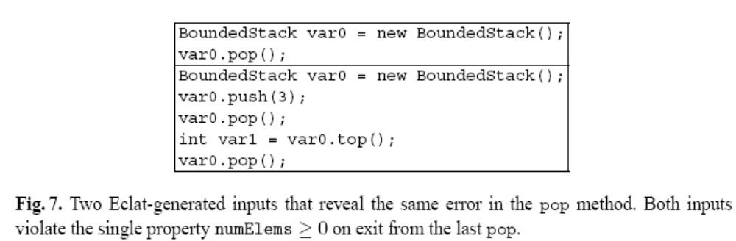
The Reducer
Violation patterns induce partition on all inputs.
Two inputs belong to the same partition if they violate the same properties.

Slide 40
Classifier Guided Input Generation
Unguided bottom-up generation which proceeds in rounds
Strategy maintains a growing pool of values used to construct new inputs.
Pool is initialized with a set of initial values (a few primitives and a null)
Every value in the pool is accompanied by a sequence of method calls that can be run to construct the value
New values are created by combining existing values through method calls
  e.g. given stack value s and value integer I, s.isMember(i) creates a new boolean value
  s.push(i) creates a new stack value
In each round, new values are created by calling methods and constructors with values from the pool
Each new value is added and its code is emitted as test input

Slide 41
Combining Generation & Classification
Unguided strategy likely to produce interesting inputs and a large number of illegal ones
Guided strategy uses classifier to guide the process
For each round:
  Construct a new set of candidate values (and corresponding inputs) from existing pool
  Classify new candidates using classifier
  Discard inputs labeled illegal, add values represented by normal operation to the pool, emit inputs labeled fault-revealing (but don’t add them to the pool)
This enhancement removes illegal and fault-revealing inputs from the pool upon discovery

Slide 42
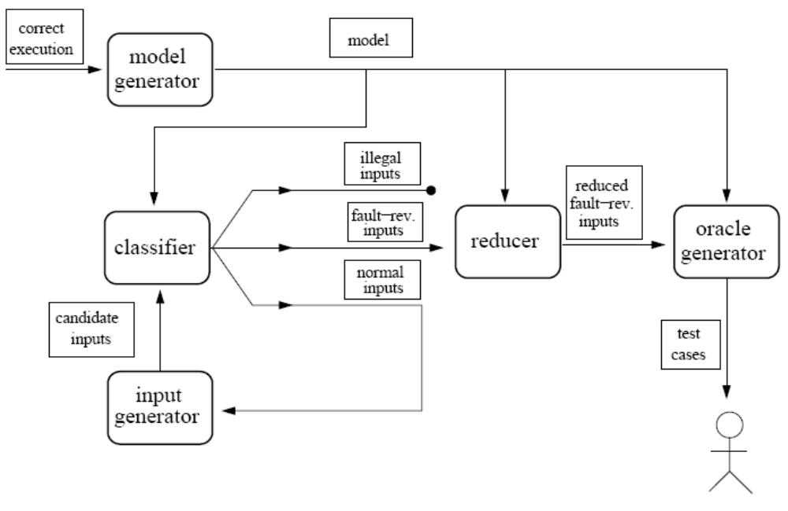
Complete Framework

Slide 43
Other Issues
Operational Model can be complemented with manual written specifications
Evaluated on numerous subject programs
Presented independent evaluation of Eclat’s output, the Classifier, the Reducer, Input Generator
Eclat revealed unknown errors in the subject programs

Slide 44



Symstra: Framework for Generating Unit Tests using Symbolic Execution (2005)
Tao Xie Darko Wolfram David
Marinov Schulte Notkin

Slide 45
Binary Search Tree Example
public class BST implements Set {
  Node root;
  int size;
  static class Node {
  int value;
  Node left;
  Node right;
  }
  public void insert (int value) { … }
  public void remove (int value) { … }
  public bool contains (int value) { … }
  public int size () { … }
}

Slide 46
Other Test Generation Approaches
Straight forward – generate all possible sequences of calls to methods under test
Cleary this approach generates too many and redundant sequences
  BST t1 = new Bst(); BST t2 = new Bst();
  t1.size(); t2.size();
  t2.size();

Slide 47
Other Test Generation Approaches
Concrete-state exploration approach
  Assume a given set of method calls arguments
  Explore new receiver-object states with method calls (BFS manner)

Slide 48
Exploring Concrete States
Method arguments: insert(1), insert(2), insert(3), remove(1), remove(2), remove(3)
1st Iteration
new BST()
remove(1)
remove(2)
remove(3)
insert(1)
insert(2)
insert(3)
1
2
3

Slide 49
Exploring Concrete States
Method arguments: insert(1), insert(2), insert(3), remove(1), remove(2), remove(3)
2nd Iteration
new BST()
remove(1)
remove(1)
remove(2)
remove(3)
insert(1)
insert(2)
insert(3)
remove(2)
1
2
3
remove(3)
insert(2)
insert(3)
1
1
2
3

Slide 50
Generating Tests from Exploration
Collect method sequences along the shortest path
2nd Iteration
new BST()
remove(1)
remove(1)
remove(2)
remove(3)
insert(1)
insert(2)
insert(3)
remove(2)
1
2
3
remove(3)
insert(2)
insert(3)
BST t = new BST();
t.insert(1);
t.insert(3);
1
1
2
3

Slide 51
Exploring Concrete States Issues
Not solved state explosion problem
  Need at least N different insert arguments to reach a BST with size N
  experiments shows memory runs out when N = 7
Requires given set of relevant arguments
  in our case insert(1), insert(2), remove(1), …

Slide 52
Concrete States → Symbolic States
new BST()
new BST()
remove(1)
remove(1)
remove(2)
remove(3)
insert(1)
insert(2)
insert(3)
insert(x1)
remove(2)
1
2
3
x1
remove(3)
insert(2)
insert(3)
insert(x2)
1
1
X1<x2
2
x1
3
x2

Slide 53
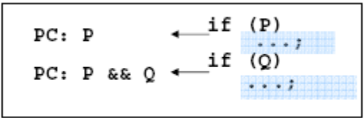
Symbolic Execution
Execute a method on symbolic input values
  Inputs: insert(SymbolicInt x)
Explore paths of the method
Build a path condition for each path
  Conjunct conditionals or their negations
Produce symbolic states (<heap, path condition>)
  For example
X1<x2
x1
x2

Slide 54
Exploring Symbolic States
public void insert(SymbolicInt x) {
if (root == null) {
root = new Node(x);
} else {
Node t = root;
while (true) {
if (t.value < x) {
// explore rigtht subtree
} else if (t.value > x) {
// explore left subtree
} else return;
}
}
}
size++;
}
new BST()
S1
insert(x1)
S2
x1
insert(x2)
S3
S4
S5
X1= x2
X1>x2
X1<x2
x1
x1
x1
x2
x2

Slide 55
Generating Tests from Exploration
Collect method sequences along
the shortest path
Generate concrete arguments by using
a constraint solver
new BST()
S1
BST t = new BST();
t.insert(x1);
t.insert(x2);
insert(x1)
S2
x1
insert(x2)
S3
S4
X1<x2
X1>x2
X1>x2
x1
x1
x2
x2
BST t = new BST();
t.insert(-1000000);
t.insert(-999999);

Slide 56
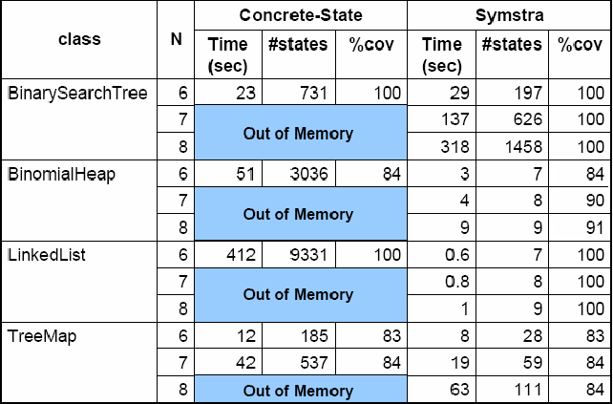
Results

Slide 57
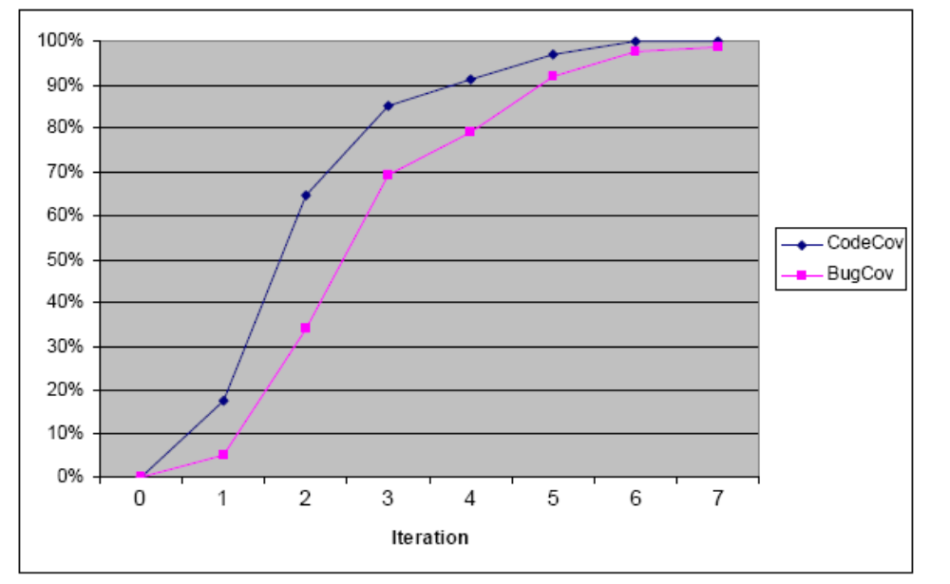
Results

Slide 58
More Issues
Symstra uses specifications (pre, post, invariants) written in JML. These are transformed to run-time assertions
Limitations:
  can not precisely handle array indexes
  currently supports primitive arguments
  can generate non-primitive arguments as sequence of method calls. These eventually boil down to methods with primitive arguments

Slide 59
Automatic Test Factoring For Java (2005)
David Saff
Shay Artzi
Jeff H. Perkins
Ernst D. Michael

Slide 60
Introduction
Technique to provide benefits of unit tests to a system which has system tests
Creates fast, focused unit tests from slow system-wide tests
Each new unit test exercises only a subset of the functionality exercised by the system tests.
Test factoring takes three inputs:
  a program
  a system test
  partition of the program into “code under test” and (untested) “environment”

Slide 61
Introduction
Running factored tests does not execute the “environment”, only the “code under test”
This approach replaces the “environment” with mock objects
These can simulate expensive resources. If the simulation is faithful then a test that utilizes the mock object can be cheaper
Examples of expensive resources:
  databases, data structures, disks, network, external hardware

Slide 62
Capture & Replay technique
Capture stage executes system tests, recording all interactions between “code under test” and “environment” in a “transcript”
In replay, “code under test” is executed as usual, but points of interaction with the “environment”, the value recorded in the “transcript” is used

Slide 63
Mock Objects
Implemented with a lookup tables – “transcript”
Transcript contains list of expected method calls
Entry consists of: method name, args, retval
Mock maintains an index into the transcript.
When called, mock verifies that method name and args are consistent with transcript, returns the retval and increments index

Slide 64
Test Factoring inaccuracies
Let T be “code under test”, E the “environment” and Em the mocked “environment”
Testing T’ (changed T) with Em produces faster results when testing T’ with E, but we can get a ReplayException.
This indicates that the assumption that T’ uses E the same way T does is wrong
In this case, test factoring must be run again with T’ and E to obtain a test result for T’ and to create a new E’m

Slide 65
Instrumenting Java classes
Capture technique relies on instrumenting java classes
The technique should know how to handle:
  all of the Java language
  class loaders
  native methods
  Reflection
Should be done on bytecode (source code not always available)

Slide 66
Capturing Technique
Done by instrumenting java classes
The technique should know how to handle:
  all of the Java language
  class loaders
  native methods
  Reflection
Should be done on bytecode (source code not always available)
Instrumented code must co-exist with uninstrumented version. Must have access to original code to avoid infinite loops

Slide 67
Capturing Technique
Built-in system classes need special care
  Instrumenting must not add or remove fields nor methods in some classes, otherwise the JVM might crash
  Can not be instrumented dynamically, because the JVM loads around 200 classes before and user code can take effect.

Slide 68
Capturing Technique
Need to replace some object references to different (capture/replaying) objects.
Can’t be done by subclassing because of
  final classes and methods
  reflection
Use interface introduction, change each class reference to an interface reference
When capturing replacement objects implementing the interface are wrappers around the real ones, and record to a transcript arguments and return values
When replaying the replacement objects are mock objects

Slide 69
Complications in capturing
Field access
Callbacks
Objects passed across the boundary
Arrays
Native methods and reflection
Class loaders
Common library optimizations – is String or ArrayList part of T or E?

Slide 70
Case Study
Evaluated test factoring on Daikon
Daikon consists of 347,000 lines and uses sophisticated constructs: reflection, native calls, callbacks and more…
Code is still under development.
All errors were real errors made by the developers
Recall that, test factoring aims on minimizing testing times
Used Daikon’s CVS log. Reconstruct code base before each check-in, and ran the tests with and without test factoring.

Slide 71
Case Study
Daikon has unit tests and regression tests
Unit Tests are automatically executed each time the code is compiled
The 24 regression tests take about 60 minutes to run (15 minutes with make)
Simulated continuous testing as a base line.
  Runs as many tests as possible as long as the code compiles

Slide 72
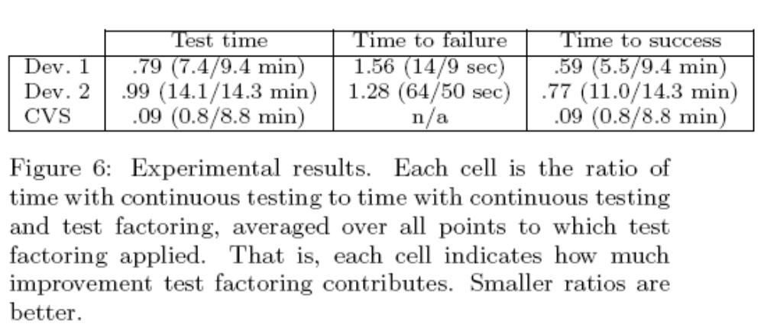
Case Study
Test time – the amount of time required to run the tests
Time to failure – time between error was introduced and the first test failure in the test suite
Time to success – time between starting tests and successfully completing them (Successful test suite completion always requires running the entire suite)

Slide 73
Other Capture & Replay Tools
Substra: A framework for Automatic Generation of Integration Tests
  Automatic generation of integration tests.
  Based on call sequence constraints inferred from initial-test executions or normal runs of subsystem
  Two types of sequence constraints:
    Shared subsystem states (m1 exit states = m2 entry state)
    Object define use relationships (if retval r of m1 is receiver or an argument of m2)
  Tool can generate new integration tests that exercise new program behavior.

Slide 74
Other Capture & Replay Tools
Selective Capture and Replay of Program Executions
  Allows selecting a subsystem of interest
  Allows capturing at runtime interactions between subsystem and rest of application
  Allows replaying recorded interaction on subsystem in isolation
  Efficient technique, capture information only relevant to considered execution

Slide 75
Other Capture & Replay Tools
Carving Differential Unit Test Cases from System Test Cases
  DUT are a hybrid of unit and system tests
  Contributions:
    framework for automating carving and replaying
    new state based strategy for carving and replay at a method level that offers a range of costs, flexibility, scalability
    evaluation criteria and empirical assessment when carving and replaying on multiple versions of a Java applications

Slide 76
Other Capture & Replay Tools
GenuTest
  Generating unit tests and mock objects from program runs and system tests
  Technique
    Capturing using AspectJ features vs “traditional” instrumentation methods
    Present a concept name mock aspects which intercept calls to objects and mocks their behavior.

Slide 77
More tools not mentioned…
JTest – commercial product by parasoft
Jartege – operational model formed from JML
PathFinder – symbolic execution tool by NASA
Symclat – An evolution of Eclat & Symstra
Rostra – Framework for detecting redundant object oriented unit tests
Orstra – Augmenting Generated Unit-Test Suites with Regression Oracle Checking
Agitator – www.agitar.com (I recommend you see their presentation in the site)

Slide 78
Future Directions
Further development of the current tools
Testing AOP programs
  Test integration of aspects and classes
  Test advices/aspects in isolation

Slide 79
Summary
Brief reminder of Unit Testing and the importance of automatic tools
Many automatic tools out there for many platforms: can be roughly categorized into running frameworks, generation, selection and prioritization
Concentrated on various input & oracle generation techniques through four select articles:
  JCrasher
  Eclat
  Symstra
  Automatic Test Factoring
Didn’t talk about results and evaluation techniques, but the tools do provide good promising results
Hope you enjoyed and had fun

Slide 80
Bibliography
Automatic Test Factoring for Java – David Saff, Shay Artzi, Jeff H.Perkins, Michael D. Ernst
Selective Capture and Replay of Program Executions – Alessandro Orso and Bryan Kennedy
Eclat: Automatic Generation and Classification of Test Inputs – Carlos Pacheco, Michael D. Ernst
Orstra: Augmenting Automatically Generated Unit-Test Suites with Regression Oracle Checking
Substra: A Framework for Automatic Generation of Integration Tests – Hai Yuan, Tao Xie
Carving Differential Unit Test Cases from System Test Cases – Sebastian Elbaum, Hui Nee Chin, Matthew B. Dwyer, Jonathan Dokulil
Rostra: A Framework for Detecting Redundant Object-Oriented Unit Tests – Tao Xie, Darko Marinov, David Notkin
Symstra: A Framework for Generating Object-Oriented Unit Tests Using Symbolic Execution – Tao Xie, Darko Marinov, Wolfram Schulte, David Notkin
An Empirical Comparison of Automated Generation and Classification Techniques for Object Oriented Unit Testing – Marcelo d’Amorim, Carlos Pacheco, Tao Xie, Darko Marinov, Michael D. Ernst
JCrasher: An Automatic Robustness Tester for Java – Christoph Csallner, Yannis Smaragdakis

